Slide 1
Surveillance Technology Working Group
Meeting #17 1.11.2022

Slide 2
Agenda
Public Comment Review
Recommendations on Technologies
Issuing a Formal Opinion
Coming Up
Questions

Slide 3
Review
Past Decisions
Fotokite: Aerial UAS allowing for different perspectives during crisis response. Not exempt, will go through the process.
Press Release out, done with public comment period
Public comments received, received comments from SPD
Recommendation sent to the Mayor
Vacant Lot Monitoring: Sensor that detect changes in a scene to monitor lots for dumping. Not exempt, will go through the process.
Press Release out, done with public comment period
Public comments received, waiting for updated data from the requesting department
Community Asset Tracker: Camera with machine learning algorithm to identify objects within the city.
Assessed pilot, documentation provided
COPS: Cameras strategically placed around the city to aid in policing
Exempted

Slide 4
Review
Current Decisions
Flock Safety: Street cameras that capture vehicle plates.
Assessed in previous session
Public comment period completed
Samsara: Fleet management technology
Assessed in previous session
Public comment period completed

Slide 5
Review
SLAs
2 - 6 Weeks
(10 - 30
Business Days)
Every 2 Weeks
(10 Business Days)
2 Weeks
(10 Business Days)
2 Weeks
(10 Business Days)
Initial submission to determination of surveillance
Short duration meeting to vote on technology exemptions
Public comment period:
Issuance of press release
Council meeting
(*) For now public input will be received via a Google Form and in the future will be on the new website.
Submission of finalized form (by dept.) to time of recommendation.
Group will individually research; departments will get follow-up questions; group to vote yes/no; and submit recommendation.

Slide 6
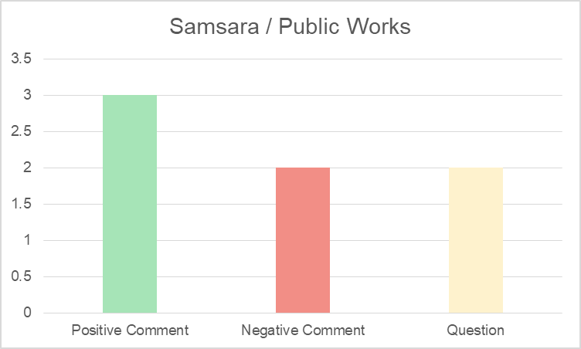
Public Comments
Public Works - Samsara
9 comments total

Slide 7
Public Comments
Public Works - Samsara
Positive feedback:
Excitement around practicality of the technology and its use and transparency it will provide.
Negative feedback:
The technology appears to be duplicative and could be invasive to residents. Concerns were also expressed about what the data collected would be used for.

Slide 8
Public Comments
Public Works - Samsara
Questions Asked:
How would the data be stored? For how long? Who has access to the data? What if the cameras catch a crime happening on the street, will the data be used in the investigation of that crime? If I am walking past a city vehicle with a camera on it, should I expect that my imagery would be captured and will my face be blurred? Do I have the right to ask for data about me to be removed? What if the camera catches imagery of me doing something inside of my private residence? Will that data be blurred? Does the vendor have access to this data? Will the metadata from the cameras be available to the vendor? How will any of this data be made public/can the public request access to this data?
Response:
We do not monitor the video on a regular basis. The information that is being collected is stored on the cloud. If the camera catches a crime it would be reported. The camera is more for road conditions and safe operation of the vehicle it doesn’t have clear images to recognize someone. The camera is not pointed at any dwellings to see what is happening inside. The vendor stores the video and does not have permission to use it without the city’s approval. There is no public access to the video. This new system has much more capabilities that our last. It monitors several machine functions to help us improve vehicle performance. It will help with routing, safety, fuel usage, productivity. It is a forward step in the modernization of city services that will help us maintain the city infrastructure in a much more efficient manner.

Slide 9
Public Comments
Public Works - Samsara
Questions Asked:
We already have GPS tracking on DPW vehicles—it’s how the plow maps can function. Why do we need images? What will these images be if?
Response:
This technology and the plow map technology are separate functions. This new system has much more capabilities that our last one and we are not running both systems on any city vehicle. Where the new system is installed the old one is removed. The images are stored on the cloud. The images are used to improve the safety of our city operators and equipment. It is a much more advanced system that helps us monitor and diagnose several machine functions as well as the safe operation of our city equipment.

Slide 10
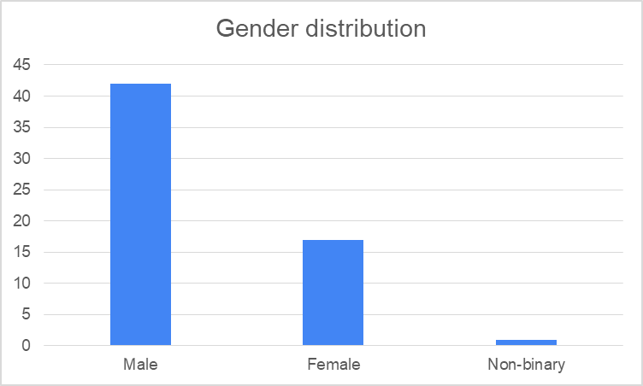
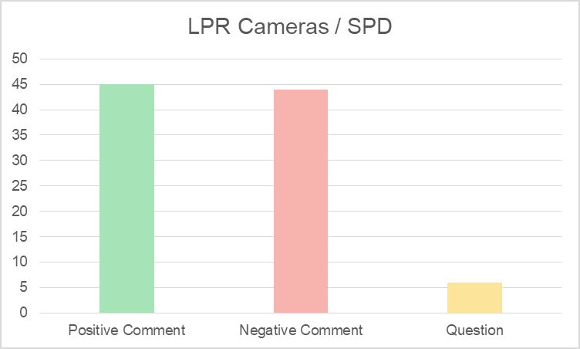
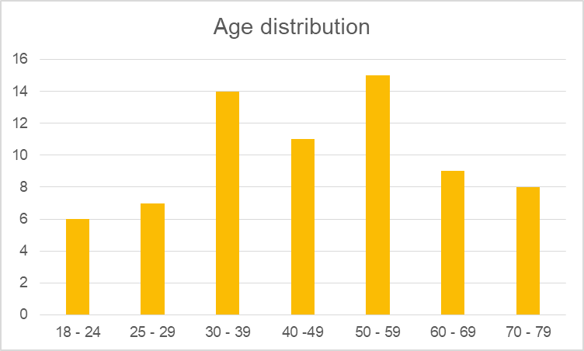
Public Comments
Syracuse Police - FlockSafety/IK Systems
98 comments total

Slide 11
Public Comments
Syracuse Police - FlockSafety/IK Systems
Completely against any type of surveillance
It is absolutely ridiculous to think that it would be appropriate to add more surveillance measures to a police force that already oppresses our city's people.- No data
Completely supportive of any type of surveillance
I think the police department should be allowed to use every available technology - Male, 70-79 years old
Weary of the slippery slope
I think it’s a further invasion of privacy, they state that it will not be used for anything other than investigation purposes but that is the first Step. Soon enough you will receive a ticket in the mail regarding your failure to fully stop at stop sign😊 - Male, 30-39
Lacking appropriate information
I am strongly against this proposal without having a better understanding of the limitations of how this information will be used.[...] - No data

Slide 12
Public Comments
Syracuse Police - FlockSafety/IK Systems
Somewhat supportive/somewhat against but requesting to adopt proper policies and procedures to regulate its use
I am in general opposed to the use of license plate readers for surveillance. If the city does move forward with it, I think it is essential to have a local law in place stating that 1) the data may not be accessed except under the specified conditions and by the specified people, preferably a warrant from a judge would be required; 2) that use of retrieved data is limited to the purpose for which is was retrieved, after which use it is destroyed; 3) anyone whose license plate data is accessed needs to be notified of such the same day it is accessed, and given contact information for someone they can call with questions; 4) the length of time unaccessed data is kept, after which it is destroyed; 5) annual independent 3rd-party auditing to make sure these procedures are being followed, 6) annual report made publicly available on the city's website and in a press release to the papers of statistics of how many times data was retrieved, whether it was useful in solving investigations, the results of the audit, whether there were any problems or unauthorized access; 7) signs should be posted where the cameras are in the city notifying the public that the license plate readers are being used and a phone number to call with questions; 8) all policies and local laws should be prominent on the city's website. This should be a local law instead of a policy or regulation so that it can't be changed without assent of the Common Council and a public hearing process. - No data
I approve if data is used only for criminal investigation in Syracuse and not shared with any third parties for any reason, including the hardware and software vendors. There should also be statutory limitations governing the length of time the data is stored and legal and monetary penalties for misuse of the system. - No data

Slide 13
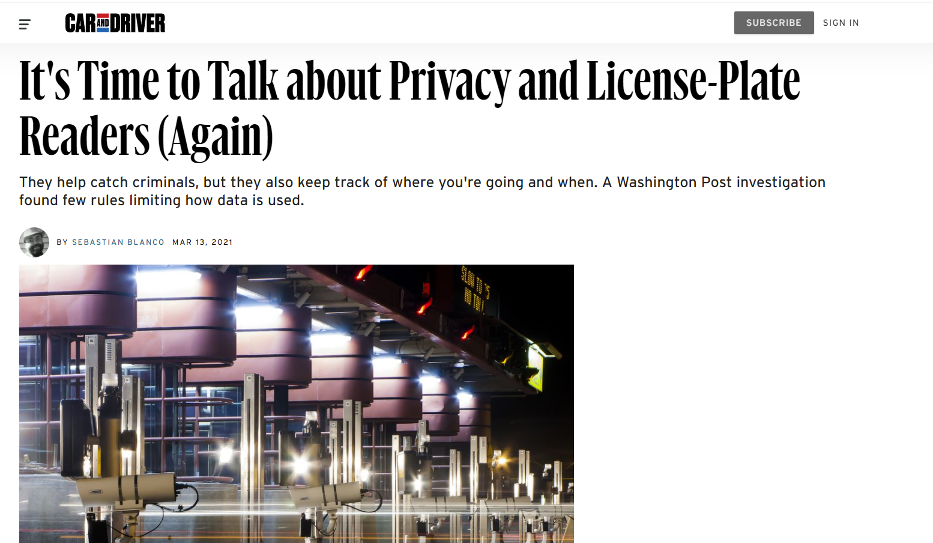
Public Comments
Reports on license plate readers submitted by the public
https://www.caranddriver.com/news/a35828850/car-license-plate-readers-privacy/
https://www.policingproject.org/axon-alpr

Slide 14
Public Comments
Syracuse Police - FlockSafety/IK Systems
Questions Asked:
I am interested in knowing if the police department has conducted a cost benefit analysis related to the implementation of this system and if it has considered the overall cost, staff resource, and technical requirements of maintaining the data generated by these license plate readers which has, as per the local government records retention schedule item number 1241 b, a 20-year retention for license plate reader data. Running these cameras 24/7 is going to generate a large amount of data that will require a significant amount of storage and a tool that will be able to appropriately parse through high volumes of data to retrieve the needed record. My concerns are that this will be an expensive system to maintain and not provide enough intellectual and legal value to make for a reasonable trade-off.
Response:
Yes, we have considered the cost. Keep in mind we do not intend to retain this data (unless it becomes evidence in a criminal case) for more than 30-60 days.

Slide 15
Public Comments
Syracuse Police - FlockSafety/IK Systems
Questions Asked:
If someone were going to commit a crime, what percentage of individuals actually drive their own vehicle with their own plates to the crime scene? How many cars are currently in these high crime targeted area with stolen or incorrect plates? How do these cameras actually help solve the crime in that case? It won't provide you with a name or address of an owner. You would only know the vehicle, which would be the same information ascertained from traffic cameras.
Response:
Our homicide investigators (some of the best in the country) have indicated that having the tools and ability to swiftly identify a plate, make, model, color of a vehicle after a homicide or serious incident has occurred, and thereby narrow down their investigations in the early stages of the crime, will be an enormous benefit in their efforts to solve these crimes and bring closure to the family members of the victim. I will add that apart from violent crime, this technology will also aid police with investigations involving AMBER alerts, endangered persons, and potentially even Project Lifesaver subjects.

Slide 16
Public Comments
Syracuse Police - FlockSafety/IK Systems
Questions Asked:
I live in strathmore. When there is an incident in the park it’s always “the cameras weren’t working at the time”. So how much money will be spent on cameras that probably won’t work?
There are so many cameras already being used from crime cameras to door bell ring cameras. Is there not a way to create 1 camera network and require the police to compensate residents for permission to use our camera footage. If these cameras help catch 2 criminals, would they be worth the return on investment? How much are these investments projected to cost? Can they be used to clear people as well as convict people?
Response:
I am very familiar with the Strathmore cops cameras and would be happy to discuss their operation at length. Please call my direct office line 315-442-5258
SPD does go door to door asking neighbors for assistance after major incidents, which does include requesting footage from ring and other private security cameras. Most residents are willing to help out of civil responsibility and not monetary payment.

Slide 17
Public Comments
Syracuse Police - FlockSafety/IK Systems
Questions Asked:
If this doesn’t track individuals how is the information shared with law enforcement during an active investigation? Additionally, how are these images stored and transferred when being utilized for investigations? Is there a evidence handling form or an official request for the images? How will the licenses be correlated to other pieces of personal information? Will the use of the images shared with the department be encrypted at rest and encrypted during transit? How will you ensure/enforce properly handling of these? Does the third party have a cyber security program, incident response plan and BCP in case it gets breached/hit with ransomware? What is Syracuse’s contingency plan if the third party has a data breach and the images and information are leaked publicly? How will you protect the right to privacy? Will the city obtain the right to audit the systems and verify the data being collected is stored, transferred and being held securely? What is the city’s requirements for the third party to maintain and adhere to its information protection policies?
Response:
I'd be happy to chat with you regarding how this technology will assist police in both investigations and apprehension of suspects and\or locating victims of AMBER alerts, Endangered persons, or Project Lifesaver victims. For the questions about encryption and data breaches, although I can speak generally about these topics, I'd much rather put you in touch with technology experts on either the police department or Flock Safety. Please call my direct office line at 315-442-5258.

Slide 18
Public Comments
Syracuse Police - FlockSafety/IK Systems
Questions Asked:
The CRB has several questions regarding the proposed policy of placing approximately twenty-five cameras at strategic intersections around the city to capture vehicular movement. Among those questions are as follows: What will the criteria be for which Syracuse Police Department decides to turn the cameras on? Will they be on all the time capturing license plates in a wide net for review later, or will they be turned on at strategic times to capture specific, targeted behavior? What will be the policy regulating the retention and destruction of the evidence collected by these cameras? The request for comment indicates it will be done in accordance with New York State law, but what specific regulations will be added by the Syracuse Police Department and/or the Syracuse City Surveillance Technology Advisory Group to make the retention and destruction of data more in line with our community standards? In what neighborhood(s) will the cameras be placed, and why would those be the neighborhoods that are chosen? Will these cameras be placed in specific neighborhoods, or will they be positioned at busy intersections throughout the city? Will the data be available to the CRB when it is needed by the Board? The CRB has requested COPS camera footage before and it was denied or was unavailable. The CRB would like the Department to agree to provide said footage when it’s available on cases without the need for a specific inquiry. We would like this evidence added to the checklist utilized between OOPS and CRB. Will this begin as a pilot program, or will it be implemented as a full-time program? If it is a pilot program, what will the criteria be to judge its success and/or failure, and what criteria will be used to decide to implement it as a full-time program? What are the policies, rules and procedures that will be put into place to govern the program? How will the program be implemented? How will officers be trained on the new program and its corresponding policy, rules and regulations? What will be the disciplinary policy for officers who violate the Surveillance Technology Policy regulations? Other than the Syracuse City Surveillance Technology Advisory Group, what advisory groups have been consulted regarding this policy? When the policies have been drafted, will the CRB have an opportunity to review and comment on them? The CRB believes that each of these questions need to be fully answered and presented to the public for review and comment prior to implementation of the surveillance technology policy addressed in the request for comment. In order for such a program to be successful, the public needs to be made aware of the purpose of the program, the targets of the program, the implementation of the program, the governance of the program, and the management of the program. Until these concerns are presented to the public and provided an opportunity to comment on, the CRB feels that such a program should not be implemented.

Slide 19
Public Comments
Syracuse Police - FlockSafety/IK Systems
Response:
Hello and thank you for your questions. I believe most of these were answer during our meeting on Dec. 27, 2021. If not, I am happy to chat with your further on these questions and concerns.

Slide 20
Technology Summary
Applicant name: Rich DeVesty Company: City of Syracuse - DPW Sponsoring Department: Fleet Operations | Application Date: 11/14/21 Partner Organization/Technologies: Samsara | Proof of Concept Demonstration? Technology Implementation? Exempt?
Technology Purpose: To provide real time tracking of DPW vehicles and equipment and to provide camera images along routes. |  | Operation/Implementation description: The technology will be installed on DPW trucks and equipment.
Data Management Plan: Fleet Operations will have access to the data through a web portal. The data will live and be available for 10 years. Access to this data is guarded by credentials. Only Superintendents will have access to this data Cloud vs on prem: Cloud-based server | Intended Operation: The technology will be permanently installed and will operate continuously. This technology will assist the DPW in both tracking their vehicles but also in ensuring the safety and accountability for their crews as there are front facing cameras that are included | Maintainability/Scalability/Reliability/Vulnerabilities: Unknown Cybersecurity Plan: Unknown Broader Impacts/Unintended Consequences/Concerns: Unknown | Who is the audience for this system?: DPW Supervisors and Administration How many units/how is the system deployed?: Unknown Volume, size and type of data: ICamera footage Length of time application is expected to be used: Indefinitely
X

Slide 21
Technology Summary
Applicant name: SPD Company: Flock Safety Sponsoring Department: Syracuse Police Department | Application Date: 10/04/21 Partner Organization/Technologies: Flock Safety | Proof of Concept Demonstration? Technology Implementation? Exempt?
Technology Purpose: Street cameras that capture still photos and also vehicle license plates to add police with investigations and apprehension of suspect after criminal activity has occurred. |  | Operation/Implementation description: The technology will be installed on free-standing poles on city streets or in overlays of currently existing cops cameras. Locations were chosen consulting analysts and officers. 57 locations were pinpointed, covering the entire City. Pilot will run for 90 days.
Data Management Plan: The data will be collected and stored by Flock Safety and retained for one month and will be destroyed with and auto override. SPD will be responsible for ensuring compliance. Retention follows standards set by the New York State Educational Law. Cloud vs on prem: Cloud-based server (evidence.com) | Intended Operation: The technology will be permanently installed and will operate continuously. This technology will assist the Syracuse Police Department in its mission to make the city safer by improving their ability to more swiftly and effectively investigate criminal activity, as well as, apprehend those committing the crimes. | Maintainability/Scalability/Reliability/Vulnerabilities: Cybersecurity Plan: Audit trails and passwords that track what data is pulled Broader Impacts/Unintended Consequences/Concerns: | Who is the audience for this system?: Training detectives (SPOs watch cameras) - not every officer. How many units/how is the system deployed?: 75 cameras on on-off ramps, to assist on investigations Volume, size and type of data: Images, size TBD Length of time application is expected to be used: Indefinitely
X

Slide 22
Issuing a Recommendation
Questions
Are there any questions that we should be asking that we have not yet answered about these technologies?
Are there policies and procedures that the issuing department should adopt to avoid any risks?
Do we see substantial risks in the use of this technology?
Do we feel comfortable making a decision tonight?

Slide 23
Formal Group Opinion
We need a volunteer to draft the formal opinion of the group. Who would be willing to do this for us?

Slide 24
Coming Up
Finalize recommendation and send to the Mayor

Slide 25
Questions
?

