Slide 1
Surveillance Technology Working Group
Meeting #19 2.08.2022

Slide 2
Agenda
License Plate Reader (LPR)
Review and discuss recommendations spreadsheet and recent email responses from Chief Cecile.
Review and discuss recommendations from Daniel Schwartz at NYCLU
Vote regarding LPR Formal Recommendation to the Mayor
Coming Up
Questions

Slide 3
Review
Past Decisions
Fotokite: Aerial UAS allowing for different perspectives during crisis response. Not exempt, will go through the process.
Press Release out, done with public comment period
Public comments received, received comments from SPD
Recommendation was sent to the Mayor
Vacant Lot Monitoring: Sensor that detect changes in a scene to monitor lots for dumping. Not exempt, will go through the process.
Press Release out, done with public comment period
Public comments received, waiting for updated data from the requesting department
Community Asset Tracker: Camera with machine learning algorithm to identify objects within the city.
Assessed pilot, documentation provided
COPS: Cameras strategically placed around the city to aid in policing
Exempted

Slide 4
Review
Current Decisions
Flock Safety/LPRs: Street cameras that capture vehicle plates.
Assessed in previous session
Public comment period completed
The Work Group heard from SPD Officers on 1/25/22 for more information regarding this.
Samsara: Fleet management technology
Assessed in previous session
Public comment period completed
Recommendation was sent to the Mayor on 2/01
Mayor Walsh stated that he read the read the groups recommendations, and is in agreement with a qualified approval, and is in agreement with the importance of putting in appropriate policies and procedures.

Slide 5
Review
SLAs
2 - 6 Weeks
(10 - 30
Business Days)
Every 2 Weeks
(10 Business Days)
2 Weeks
(10 Business Days)
2 Weeks
(10 Business Days)
Initial submission to determination of surveillance
Short duration meeting to vote on technology exemptions
Public comment period:
Issuance of press release
Council meeting
(*) For now public input will be received via a Google Form and in the future will be on the new website.
Submission of finalized form (by dept.) to time of recommendation.
Group will individually research; departments will get follow-up questions; group to vote yes/no; and submit recommendation.

Slide 6
Review
Summary of legal guidance provided by Mujtaba Tirmizey, City of Syracuse Law Clerk:
What consent is granted when someone obtains a driver’s license?
A driver impliedly consents to LPRS capturing and storing their license plate number when they obtain a driver’s license.
2. Accountability regarding the data collected.
Audit Logs: Such audit capabilities can be an effective means to discourage unnecessary or inappropriate use of LPR data and trace any improper uses to the offending party.
Monitoring and Conducting Audits of System Use: Audits of LPRS help to ensure that law enforcement agencies are operating in accordance with the policies developed to regulate the collection, use, and dissemination of LPR data.
Policy Awareness and Training: Personnel employed by law enforcement agencies should be informed about why policies limiting access, use, and dissemination of LPR data are important and how those policies protect the agency and the public. Full comments from Mujtaba, can be accessed on 1/25/22 Powerpoint.

Slide 7
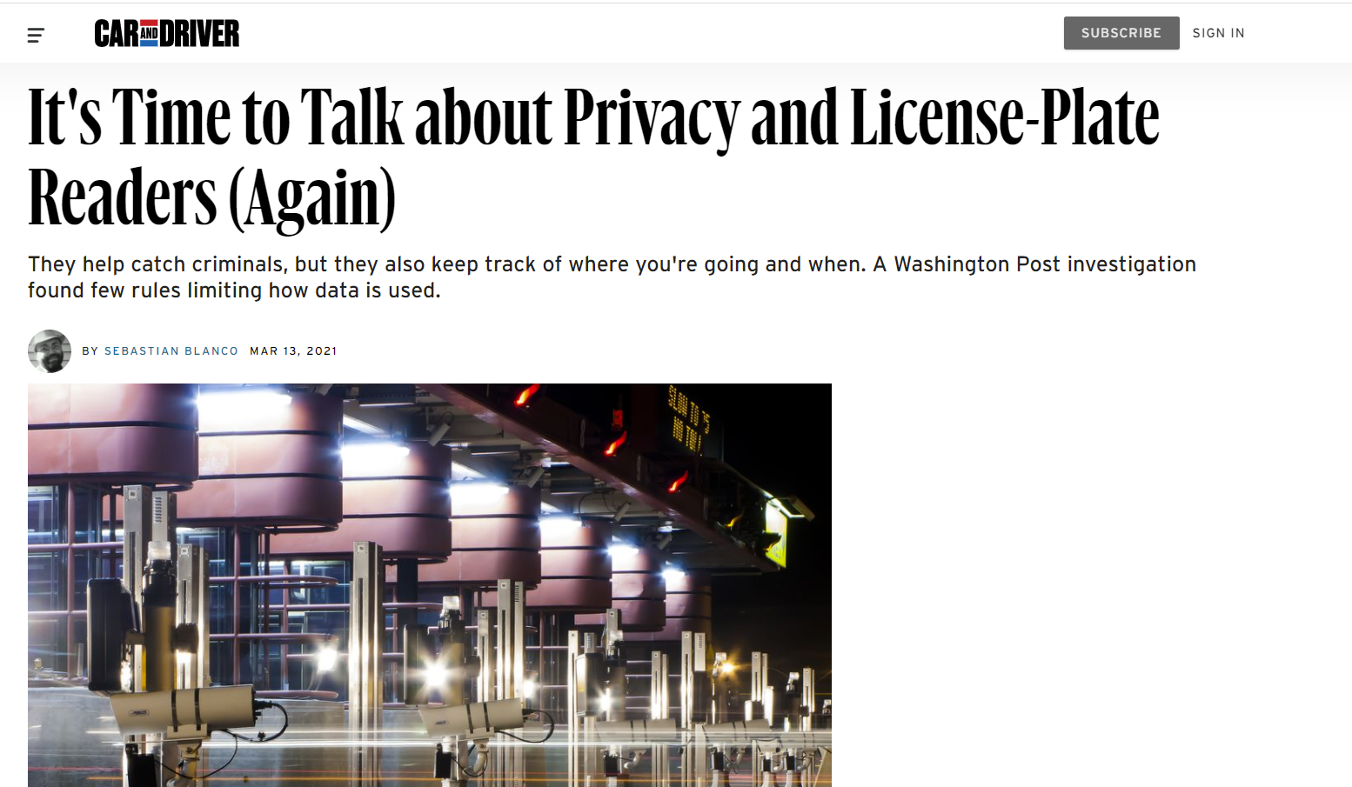
Review
Reports on license plate readers submitted by the public
https://www.caranddriver.com/news/a35828850/car-license-plate-readers-privacy/
https://www.policingproject.org/axon-alpr

Slide 8
LPR Technology Summary
Applicant name: SPD Company: Flock Safety Sponsoring Department: Syracuse Police Department | Application Date: 10/04/21 Partner Organization/Technologies: Flock Safety | Proof of Concept Demonstration? Technology Implementation? Exempt?
Technology Purpose: Street cameras that capture still photos and also vehicle license plates to add police with investigations and apprehension of suspect after criminal activity has occurred. |  | Operation/Implementation description: The technology will be installed on free-standing poles on city streets or in overlays of currently existing cops cameras. Locations were chosen consulting analysts and officers. 57 locations were pinpointed, covering the entire City. Pilot will run for 90 days.
Data Management Plan: The data will be collected and stored by Flock Safety and retained for one month and will be destroyed with and auto override. SPD will be responsible for ensuring compliance. Retention follows standards set by the New York State Educational Law. Cloud vs on prem: Cloud-based server (evidence.com) | Intended Operation: The technology will be permanently installed and will operate continuously. This technology will assist the Syracuse Police Department in its mission to make the city safer by improving their ability to more swiftly and effectively investigate criminal activity, as well as, apprehend those committing the crimes. | Maintainability/Scalability/Reliability/Vulnerabilities: Cybersecurity Plan: Audit trails and passwords that track what data is pulled Broader Impacts/Unintended Consequences/Concerns: | Who is the audience for this system?: Training detectives (SPOs watch cameras) - not every officer. How many units/how is the system deployed?: 75 cameras on on-off ramps, to assist on investigations Volume, size and type of data: Images, size TBD Length of time application is expected to be used: Indefinitely
X

Slide 9
License Plate Reader
Questions from the Work Group were sent to Chief Cecile, who provided responses
Should be a local law instead of a policy | Not possible | It would be difficult to make this a local law rather than a policy due to the number of revisions SPD might make over time due to trainings and other changing regulations.
The data may not be accessed except under the specified conditions and by the specified people. | Could do it | Currently there are levels of access that are baked into who can access the data within the SPD.
Use of retrieved data is limited to the purpose for which is was retrieved, after which use it is destroyed. | Doing it | They have language in current policies that includes this. The data will be destroyed if it does not become evidence in an investigation. If it does become part of an investigation we will follow the NYS records retention schedule, similar to what we use for body worn cameras, cops cameras, and RMS reports.
Anyone whose license plate data is accessed needs to be notified of such the same day it is accessed. | Not possible | The number of images that could be pulled for any reason would be far to large for SPD to be able to manage and sustain over time.
Full recommendation SpreadSheet - Along with Chief Cecile’s Responses

Slide 10
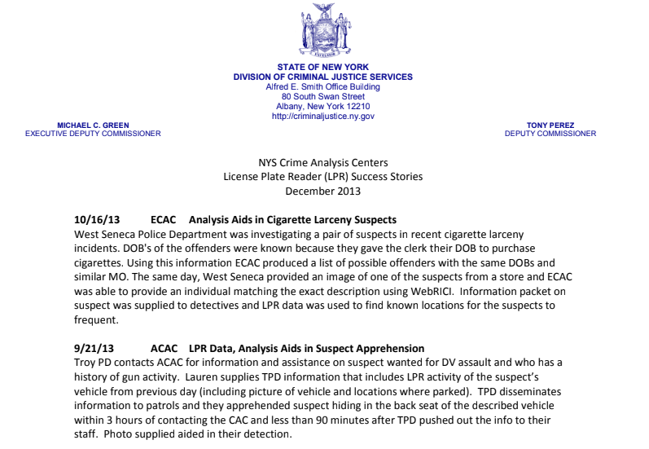
Additional LPR Information Provided by Chief Cecile
Link to full Information provided by Chief Cecile (Includes the following):
LPR Success Headlines (4 attachments)
Syracuse Police’s Current Mobile LPR Policy
Proposed LPR Locations in Syracuse
NYS Municipal Police Training Council LPR Model Policy (Dated March 2021)

Slide 11
License Plate Reader
Comments and Draft ALPR Privacy Model Bill were provided by Daniel Schwartz, NYCLU
Some highlights are:
How comprehensive, pervasive, and ultimately invasive an ALPR surveillance system is can be assessed by two main factors: the quantity of cameras in an area and how long the collected information is kept.
Unfortunately, the Syracuse Police Department’s ALPR announcement only refers to “compliance of data storage 2 and destruction as set by New York State Law.” Given the lack of meaningful protections at the state or federal level, this would allow for lengthy data retention that logs and archives our every move
Concern that the 26 proposed placements locations are disproportionately located in areas with higher Black populations (Daniel included a map).
Daniel Schwartz NYCLU Full Comments NYCLU Draft ALPR Privacy Model Bill

Slide 12
License Plate Reader
Discussion
Should the City adopt this technology?
Do we see substantial risks in the use of this technology?
FOIL implications
Inter-governmental cooperation (ICE)
Accuracy of the system
Cameras and data management
Mission creep/function creep
Are there policies and procedures that the issuing department should adopt to avoid any risks?
Data retention (establish an end date)
Any remaining questions?

Slide 13
License Plate Readers
Votes
STWG Member | Vote in Favor | Vote in Favor w/Stipulations | Vote Against | Abstention | Absence
Kelsey May
Sharon Owens
Martha Grabowski
Mark King
Ken Stewart
Chief Gleeson
Johannes Himmelreich
Ocesa Keaton
Jen Tifft

Slide 14
License Plate Readers
Votes
STWG Member | Vote in Favor | Vote in Favor w/Stipulations | Vote Against | Abstention | Absence
Lanessa Chaplin
Mujtaba T.
Michelle S.
Jake Dishaw
John Kane
Brian Eisenberg
Nico Diaz
Jason Scharf
Chief Cecile

Slide 15
Stipulation
Micro-policy for 90 day period
Data retention
Drafting sub-committee: Johannes, Daniel, Nico, Mark, Kelsey
Success criteria

Slide 16
Coming Up
Draft formal recommendation from the group for LPR
Decide on a volunteer drafter

Slide 17
Questions
?

