Slide 1
Surveillance Technology Working Group
Meeting #20 2.22.2022

Slide 2
Agenda
License Plate Reader (LPR)
Review and discuss the Guidelines proposed by the LPR Subcommittee
Vote regarding LPR Formal Recommendation to the Mayor
Coming Up
Questions

Slide 3
Review
Past Decisions
Fotokite: Aerial UAS allowing for different perspectives during crisis response. Not exempt, will go through the process.
Press Release out, done with public comment period
Public comments received, received comments from SPD
Recommendation was sent to the Mayor
Vacant Lot Monitoring: Sensor that detect changes in a scene to monitor lots for dumping. Not exempt, will go through the process.
Press Release out, done with public comment period
Public comments received, waiting for updated data from the requesting department
Community Asset Tracker: Camera with machine learning algorithm to identify objects within the city.
Assessed pilot, documentation provided
COPS: Cameras strategically placed around the city to aid in policing
Exempted

Slide 4
Review
Current Decisions
Flock Safety/LPRs: Street cameras that capture vehicle plates.
Assessed in previous session
Public comment period completed
The Work Group heard from SPD Officers on 1/25/22 for more information regarding this.
Samsara: Fleet management technology
Assessed in previous session
Public comment period completed
Recommendation was sent to the Mayor on 2/01
Mayor Walsh stated that he read the read the groups recommendations, and is in agreement with a qualified approval, and is in agreement with the importance of putting in appropriate policies and procedures.

Slide 5
Review
Service Level Agreements (SLAs)
2 - 6 Weeks
(10 - 30
Business Days)
Every 2 Weeks
(10 Business Days)
2 Weeks
(10 Business Days)
2 Weeks
(10 Business Days)
Initial submission to determination of surveillance
Short duration meeting to vote on technology exemptions
Public comment period:
Issuance of press release
Council meeting
(*) For now public input will be received via a Google Form and in the future will be on the new website.
Submission of finalized form (by dept.) to time of recommendation.
Group will individually research; departments will get follow-up questions; group to vote yes/no; and submit recommendation.

Slide 6
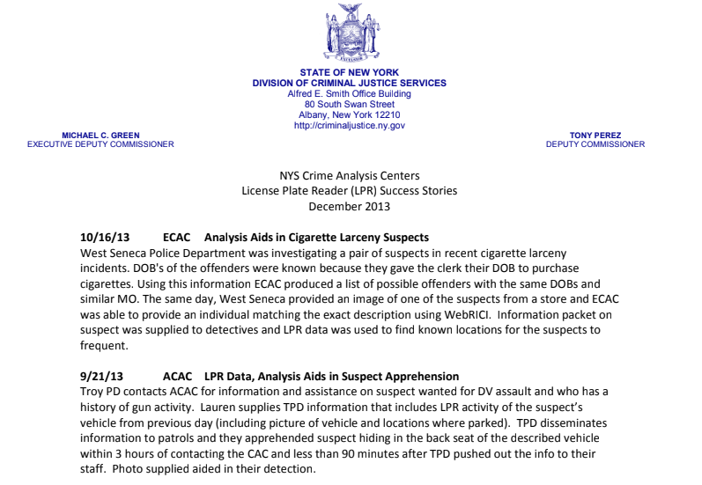
Additional LPR Information Provided by Chief Cecile
Link to full Information provided by Chief Cecile (Includes the following):
LPR SPD Lexipol Draft Policy
LPR Success Headlines (4 attachments)
Syracuse Police’s Current Mobile LPR Policy
Proposed LPR Locations in Syracuse
NYS Municipal Police Training Council LPR Model Policy (Dated March 2021)

Slide 7
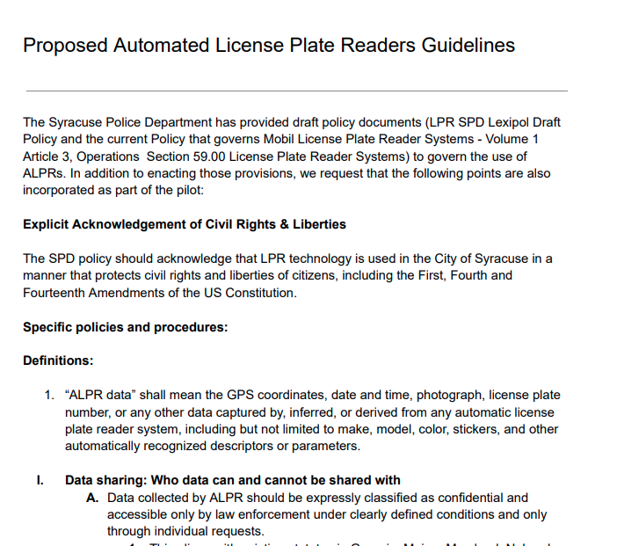
License Plate Reader
Proposed ALPR Guidelines Categories
Link to Full Document
Data sharing: Who data can and cannot be shared with.
Permissible Uses of LPR Technology
How long data can be retained for
Policies addressing technological limitations on accuracy
Reporting and audits

Slide 8
License Plate Reader
Discussion
Should the City adopt this technology as a pilot?
Does the group feel that the proposed guidelines are sufficient for a 90 day pilot?
Any remaining questions?

Slide 9
License Plate Readers
Votes
STWG Member | Vote in Favor | Vote in Favor w/Stipulations | Vote Against | Abstention | Absence
Kelsey May |  |  |  | x
Sharon Owens |  | x
Martha Grabowski |  | x
Mark King |  | x
Ken Stewart | X
Chief Gleeson |  | x
Johannes Himmelreich |  |  |  |  | X (Excused)
Ocesa Keaton |  |  |  |  | x
Jen Tifft |  | x

Slide 10
License Plate Readers
Votes
STWG Member | Vote in Favor | Vote in Favor w/Stipulations | Vote Against | Abstention | Absence
Daniel Schwarz |  |  |  | x
Mujtaba T. |  | x
Michelle S. |  |  |  | x
Jake Dishaw |  |  |  |  | x
John Kane |  | X
Brian Eisenberg |  |  |  |  | x
Nico Diaz |  | x
Jason Scharf |  | x
Chief Cecile |  | x

Slide 11
Coming Up
Drafting final recommendation to the Mayor
Need a volunteer
Next session: Revisiting group norms

Slide 12
Questions
?

