Slide 1
Surveillance Technology Working Group
Meeting #23 4.12.2022

Slide 2
Agenda
Cyclomedia - Right of Way Imaging (Currently in Public Comment Period until 4/19/22)
Follow up on STWG internal norms and policies
Votes regarding proposed changes
Coming Up
Questions

Slide 3
Review
Past Decisions
Fotokite: Aerial UAS allowing for different perspectives during crisis response. Not exempt, will go through the process.
Press Release out, done with public comment period
Public comments received, received comments from SPD
Recommendation was sent to the Mayor
Vacant Lot Monitoring: Sensor that detect changes in a scene to monitor lots for dumping. Not exempt, will go through the process.
Press Release out, done with public comment period
Public comments received, waiting for updated data from the requesting department
Community Asset Tracker: Camera with machine learning algorithm to identify objects within the city.
Assessed pilot, documentation provided
COPS: Cameras strategically placed around the city to aid in policing
Exempted

Slide 4
Review
Current Decisions
Samsara: Fleet management technology
Assessed in previous session
Public comment period completed
Recommendation was sent to the Mayor on 2/01
Mayor Walsh stated that he read the read the groups recommendations, and is in agreement with a qualified approval, and is in agreement with the importance of putting in appropriate policies and procedures.
Flock Safety/ALPRs: Street cameras that capture vehicle plates.
Assessed in previous session
Public comment period completed
The Work Group heard from SPD Officers on 1/25/22 for more information regarding this.
The STWG created guidelines for ALPR Use and this was recommended to the mayor with the stipulations written on 3/11/22.

Slide 5
Review
Service Level Agreements (SLAs)
2 - 6 Weeks
(10 - 30
Business Days)
Every 2 Weeks
(10 Business Days)
2 Weeks
(10 Business Days)
2 Weeks
(10 Business Days)
Initial submission to determination of surveillance
Short duration meeting to vote on technology exemptions
Public comment period:
Issuance of press release
Council meeting
(*) For now public input will be received via a Google Form and in the future will be on the new website.
Submission of finalized form (by dept.) to time of recommendation.
Group will individually research; departments will get follow-up questions; group to vote yes/no; and submit recommendation.

Slide 6
Cyclomedia - New Request
Applicant name: Neil Burke Company: Cyclomedia Sponsoring Department: City of Syracuse - DPW | Application Date: 2/24/2022 Partner Organization/Technologies: Cyclomedia | Proof of Concept Demonstration? Technology Implementation? x Exempt?
Technology Purpose: Cyclomedia allows for desktop review of accurate and up-to-date information regarding traffic control devices. DPW oversees the public ROW and responds to issues every day of the year, this tool helps streamline our workflow and reduce miles traveled/field work - these two factors relate to resource management and safety, the less of either the better. |  | Operation/Implementation description: We will enter into a multi-year agreement, including 3 captures.
Data Management Plan: DPW and Assessment will have access to the data through a web portal. The data will live and be available for 24 months after each capture. Access to this data is guarded by credentials. Cloud vs on prem: Cloud-based server | Intended Operation: Cyclomedia would be a one time and temporary assessment of city streets. Cyclomedia provides Right of Way (ROW) imaging, somewhat similar to google streetview, provides accurate information without distortion and has accuracy/measurable data points for items in/viewable from ROW like signage, etc. | Maintainability/Scalability/Reliability/Vulnerabilities: Unknown Cybersecurity Plan: Unknown Broader Impacts/Unintended Consequences/Concerns: Unknown | Who is the audience for this system?: DPW and Assessment Staff How many units/how is the system deployed?: Unknown Volume, size and type of data: Unknown Length of time application is expected to be used: 5 Months

Slide 7
Cyclomedia - Update
Cyclomedia Press Release was put out on 4/06/2022 for Public Comment Period - HERE
Form can be accessed HERE

Slide 8
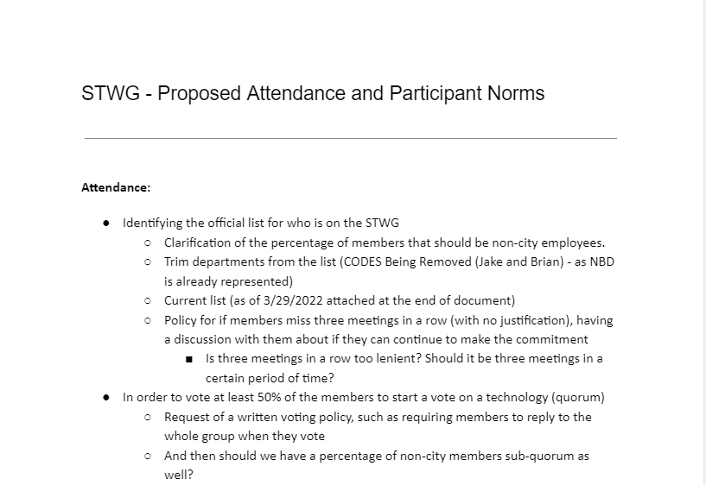
Internal Norms
Put together this document based on 3/15/2022 meeting and Survey Feedback:
View entire document

Slide 9
Internal Norms
Surv Tech Working Group Survey Highlights:
Tightening up City members membership
75% of responses stated that current attendance guidelines were too lenient
50% felt that members who are absent and did not inform committee should not get a vote
100% felt that if members have not attended for three months in a row, they should be replaced
Recommendations - Increased transparency in disclosing STWG materials for public review and comment
Sending out meeting materials farther in advance of the meetings
Full responses can be viewed HERE.

Slide 10
Internal Norms
Attendance:
​Identifying the official list for who is on the STWG
Clarification of the percentage of members that should be non-city employees.
Trimmed departments from the list (CODES Being Removed (Jake and Brian) - as NBD is already represented)
Policy for if members miss three meetings in a row (with no justification), having a discussion with them about if they can continue to make the commitment
Proposal: Unjustified absence 3 meetings in 3 months

Slide 11
Internal Norms
Attendance (Continued):
In order to vote at least 50% of the members to start a vote on a technology (quorum)
Request of a written voting policy, such as requiring members to reply to the whole group when they vote
And then should we have a percentage of non-city members sub-quorum as well?
Proposal: Have a 50% of all members to be present before we hold a recommendation vote. Of those present, at least 40% should be non-city staff.

Slide 12
Internal Norms
External Participants:
Discussed outside participants being allowed, if they are approved by the API Team and are able to answer specific questions about the technology.
Proposal: Outside participants should request permission before-hand to the API team. (announce before-hand)
Documentation for Community Review: One idea is to record the meetings and post the recordings of these meetings
Another idea is to post the meeting minutes on the STWG Website after the meetings (around the time they are emailed out to participants).
Current STWG section of the website can be viewed HERE.
Proposal: Start adding meeting notes on website

Slide 13
Internal Norms
Letter of Commitment:
Proposal: Draft letter of commitment to be drafted and sent out to members of the board for their review and signature.
Add a notice of disclosure here
For employees, add signature by department head

Slide 14
Questions
?

